Slide 1
PRIME Technology Group, LLC Company Overview for Sony Entertainment June 5, 2015

Slide 2
Agenda
Introductions
About Prime
Engagement Overview
Long Term Vision

Slide 3
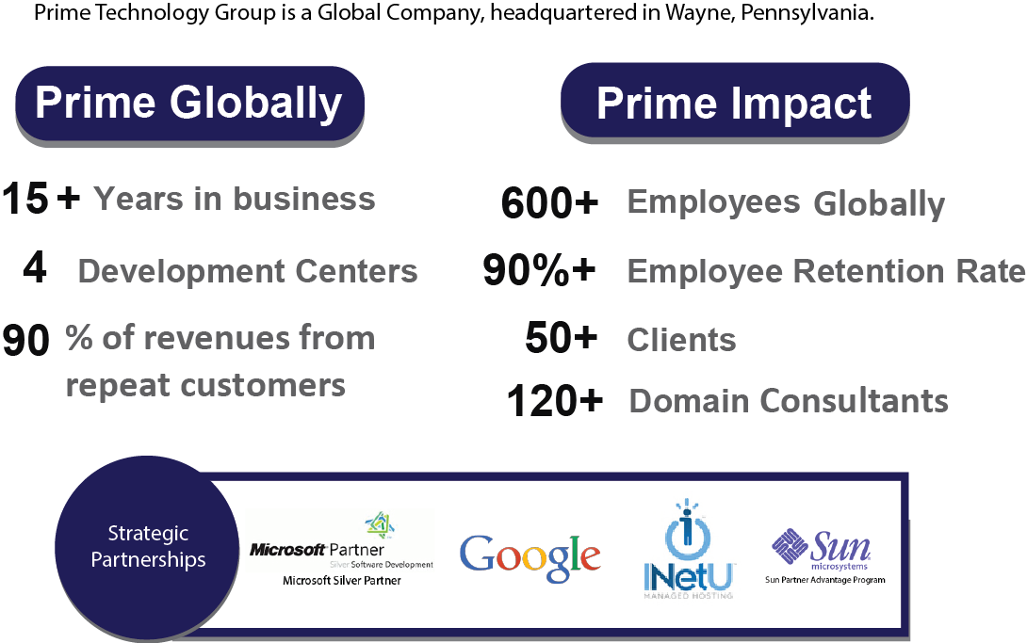
About PRIME

Slide 4
Competitive Differentiators
Hire “Best” Employees vs. Contractors
US Based Client Facing Consultants
Robust Research & Development Organization
Vertical Domain Expertise
Client Partner Approach vs. One Time Vendor
High quality, time-to-market & optimal cost solutions with a high ROI for customers
Custom fit to each situation – flexible, expandable and sustainable solution leveraging reusable technology frameworks and a global staff
Focus on people, process & technology to effectively deliver consistent, scalable solutions

Slide 5
Vertical Focus & Services Summary
Vertical Domains
Financial Services
Healthcare
Insurance
OmniChannel
Enterprise Application Services
Analytics: Predictive/Machine Learning; BI/Data Warehouse
Services
Cloud Development: PaaS. SaaS, Google, Azure, Force.com, AWS
Mobility: IBM Partnership; Native Applications

Slide 6
Horizontal Services
Enterprise Application Services
Product/Application Development
Portal Development
Application Integration
Legacy Modernization
Quality Assurance
Functional / Manual Testing
Automated Testing
Cloud
PaaS; SaaS Development
Google; Amazon; Cloudera; MS Azure
Analytics
Predictive/Machine Learning Analytics
Business Intelligence
Data Warehousing
Big Data
Mobility
IBM Partnership
Worklight
HTML5/Responsive Design
Native Application Development

Slide 7
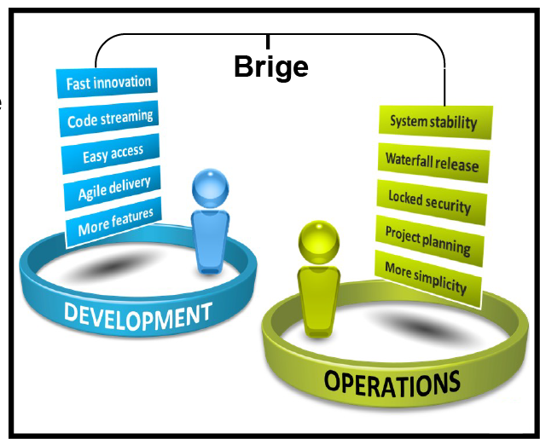
DevOps Automation
Develop
Test
Stage
Deploy
Continuous Delivery; Automated Testing; Log Monitoring; Continuous Integration
Source Control
Build
Test
Develop
Continuous Delivery with Feedback Loop
Commit
Initiate CI
Monitor
Report
Test
Feedback on issues detected in production
Leverages the power of various DevOps tools to create repeatable development environments
Easy Configuration & Provisioning using Vagrant, Puppet, Chef, Shell Scripts
Integrated support for Revision Control Systems
Integrated Console and Editors
Web Based UI to manage and monitor environments
Bridge

Slide 8
Engagement Overview

Slide 9
Current State
DeSMan Platform Overview
Dynamic Website Management Platform
Volume:
Currently managing ~225 dynamic websites
Plan to add ~400 more
Platforms supported: Wordpress (primarily), Static Websites
Technologies used: Perl, PHP, ActiveMQ, Riak CS, MySQL, OpenShift, MongoDB
Newer generation of servers/infrastructure being deployed at INetU (Gen 2)

Slide 10
Challenges
Existing architecture doesn’t scale in production
Mainly WordPress Sites
Platform is under utilized due to scalability issue
Consistency of User Interface
Diverse User Community
Varying technical skills
Varying adoption of development processes
Maintenance of Additional Tool, Fast Track, about to be assumed

Slide 11
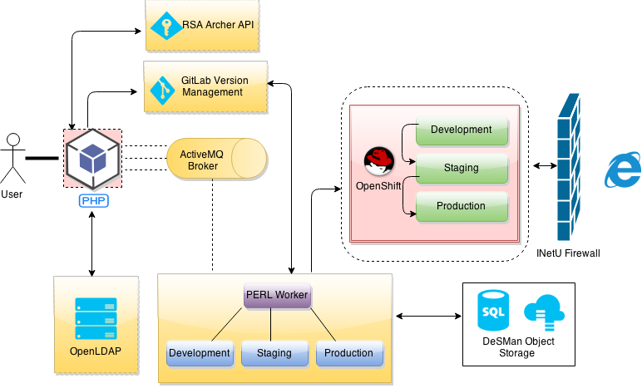
Current Architecture

Slide 12
Engagement Objectives
Short Term Goals: Address Scalability Issues Immediately
Restore Fully Functioning Tool
Intermediate Goals: Address additional Open Ticket priorities
Long Term Goals: Improve the Tool
User Experience
Work Flow
Performance
Scalability
Functionality

Slide 13
Engagement Approach
Short Term Deliverables
Address and Resolve top functional priorities (Changes made in existing code base)
Replace OpenShift with Docker
Automate code pushes: promote Development to Stage & Stage to Production on Gen 2 environment
Provide Preview/Review Functionality
Intermediate Deliverables
Address and Resolve remaining functional priorities as identified in the DeSMan RFE and Priority Bug Spreadsheet (Changes made in existing code base)
Complete open Archer API RFEs
User Interface Changes

Slide 14
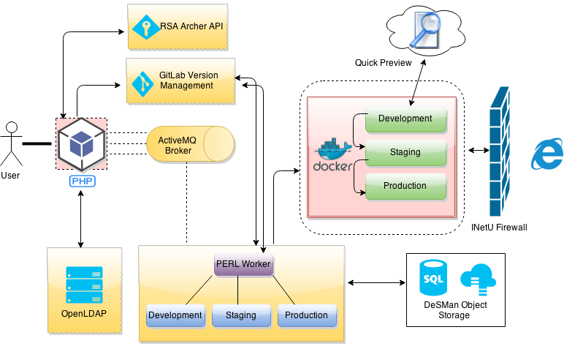
Intermediate Architecture
Replace OpenShift with Docker
Automate Code Pushes
Provide Preview/Review Functionality
Archer API RFEs
User Interface Change

Slide 15
Engagement Timelines & Team
Short Term Deliverables
Approximately 3 months
Can deliver by September with immediate start
Intermediate Deliverables
Approximately 1 month following
Engagement Team
Project Manager
Technical Project Lead
UI, DevOps & Backend Engineers
QA Engineers

Slide 16
Long Term Vision

Slide 17
Long Term Vision
Migrate DeSMan Tool
Provide Robust User Friendly Front End
Improve Scalability
Improve Performance
Enhance Features
Statistics
Analytics
Integrate Fast Track Functionality
Provides Single/Common Platform For All Users
Sunset Fast Track
Single Platform Reduces Maintenance Costs

Slide 18
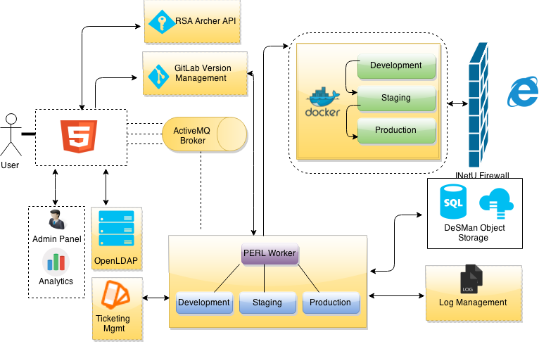
Proposed Architecture
Ticketing Management Integration
Admin Panel
Appropriate category of users
System health
DevOps Tools Integration
Logs monitoring with tools like Kibana, Elastic Search and Logstash
Continuous Integration and Delivery
Analytics for Designers

Slide 19
Long Term Vision Next Steps
Initiate Discovery Simultaneous with Initial Engagement
In Depth Analysis of DeSMan
In Depth Analysis of Fast Track
Develop Requirements Backlog for Enhanced Solution
Develop High Level Architecture & Data Model
Provide Proposal to Build Solution including Effort, Cost and Schedule

Slide 20


Slide 21
Engaging Prime

Slide 22
Engagement Types
Managed Services
Ongoing Initiatives
Team Composition
US Leadership
India Tech Team
Approach
Client Partnering
Rotation as Needed
Delivery
Collaborative Planning
Collaborative Execution
Pricing
Fixed Monthly Rate
T&M
Project Services
Defined Initiatives
Team Composition
US PM/BA
India Tech Team
Approach
Full Project Team
Blended Team w/Client Resources
Delivery
Requirements Discovery
Project Execution
Pricing
Fixed Price
T&M

Slide 23
PRIME Partner Model
Plan
Execute
Maintain
Strategic Consulting
Requirements Discovery & Analysis
Gap Analysis
Business Process Improvements
Collaborative Team
Combined Team
PRIME & Client Staff
Complete PRIME team
Dedicated Team
Product Enhancements
Post Production System & Application Support
SLA Based Outsource
PRIME Engagement Offerings

